Slide 1

Energy Climate Hackathon
Group 9:
PV Output Forecasting using Smart Meter Data of nearby PVs
Members: Carl Haines, Liang Guo, Maomao Hu, Evandro Cardozo, Nikolaus Houben
Contact address: houben@eeg.tuwien.ac.at

Slide 2
Problem Statement
More accurate very short-term forecasting (“now-casting”) techniques are needed for the integration of decentralised energy assets, e.g. PV systems, EVs, batteries
Two major reasons:
Arbitrage opportunity of microgrids and aggregators (via Power-to-X technology)
Provide ancillary services for grid operators
Common methods for very short-term forecasting include: Persistence, LSTM, SARIMA, etc

Slide 3
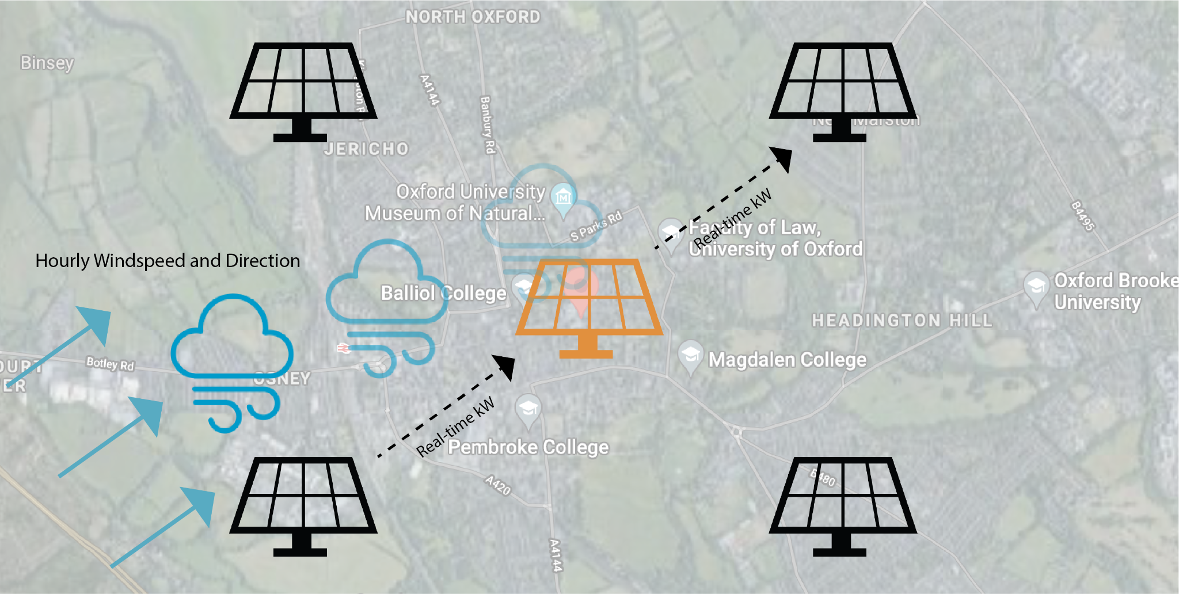
Project Idea
Peer-to-Peer Photovoltaic (PV) Forecasting (Eslinga 2017)
Idea: Using nearby PV generation data to improve the performance of a center system
Contribution of our project:
Machine Learning
Smart Feature Selection based on wind speed /direction, distance between systems, and cloud type
Notes:
Elsinga, Boudewijn, and Wilfried GJHM van Sark. "Short-term peer-to-peer solar forecasting in a network of photovoltaic systems." Applied Energy 206 (2017): 1464-1483.
APA

Slide 4
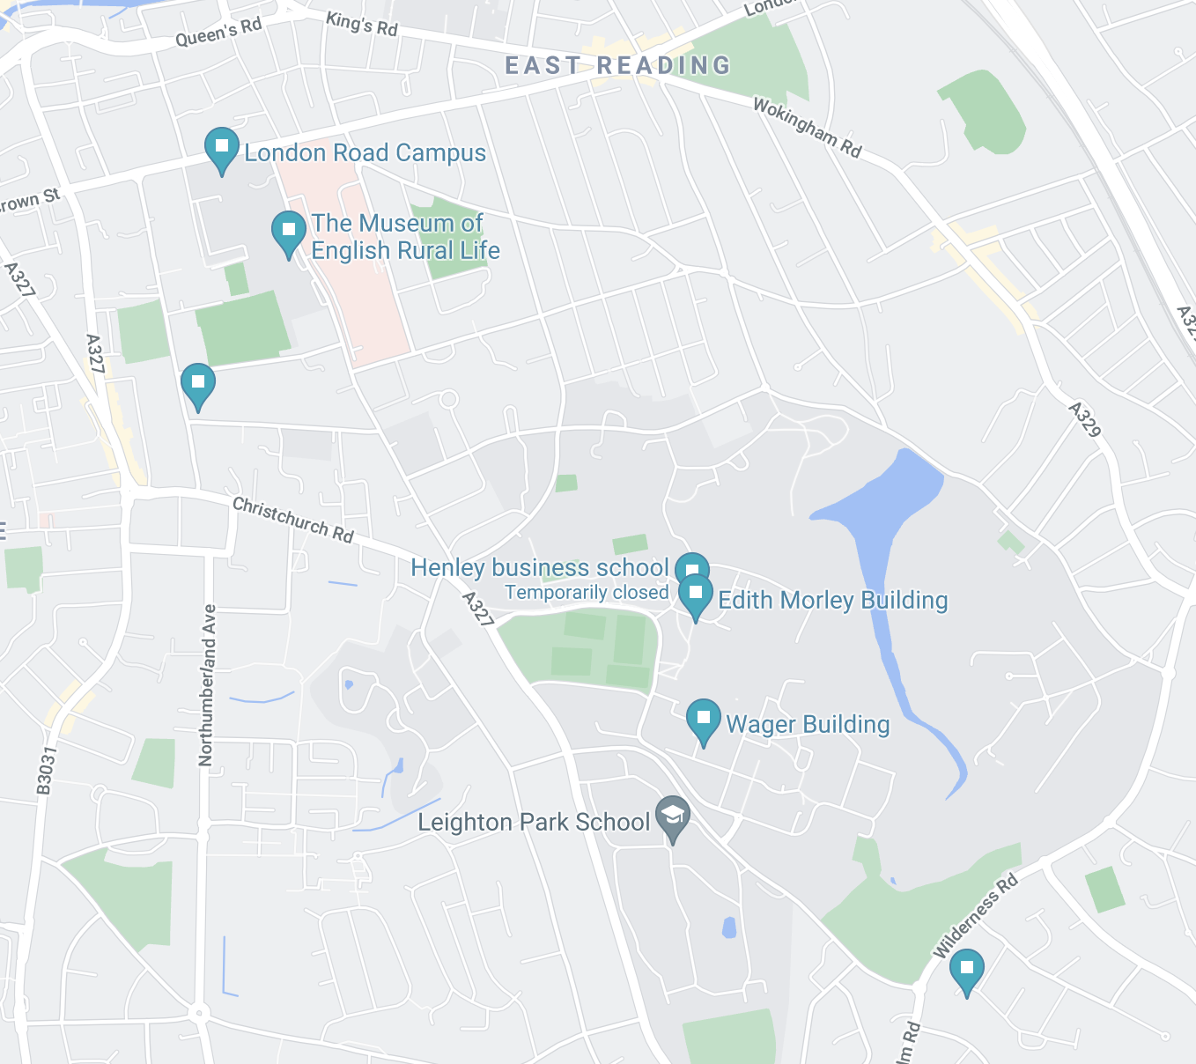
Data
PV Data:
Meter Data [kWh] from 6 PV Systems in Reading, UK
30 minutes resolution
1 year (2020-2021)
Weather Data
Reading, UK
Hourly resolution
ERA 5 - wind speed, wind direction, global radiation
1 year (2020-2021)

Slide 5
PV System Sites in Reading
Centre Systems: Edith Morley Building (in red)
Peripheral Systems: Family Home, MERL (in purple)
~ 2 km between centre and periphery system

Slide 6
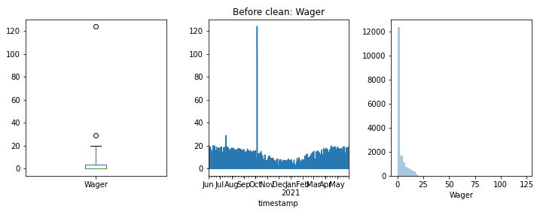
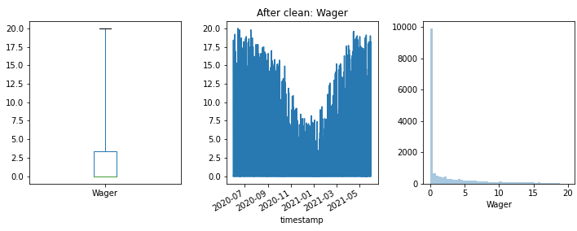
Workflow of the Hackathon
Collected the necessary data (PV, weather)
Resample Data & Merged
Outlier Detection
Created Main Dataframe
Selected Regression Algorithm
Selected a centre station
Developed Station Selection Algorithm
Conceptualised Lag Selection Algorithm
Tested & Compared the performance to benchmark

Slide 7
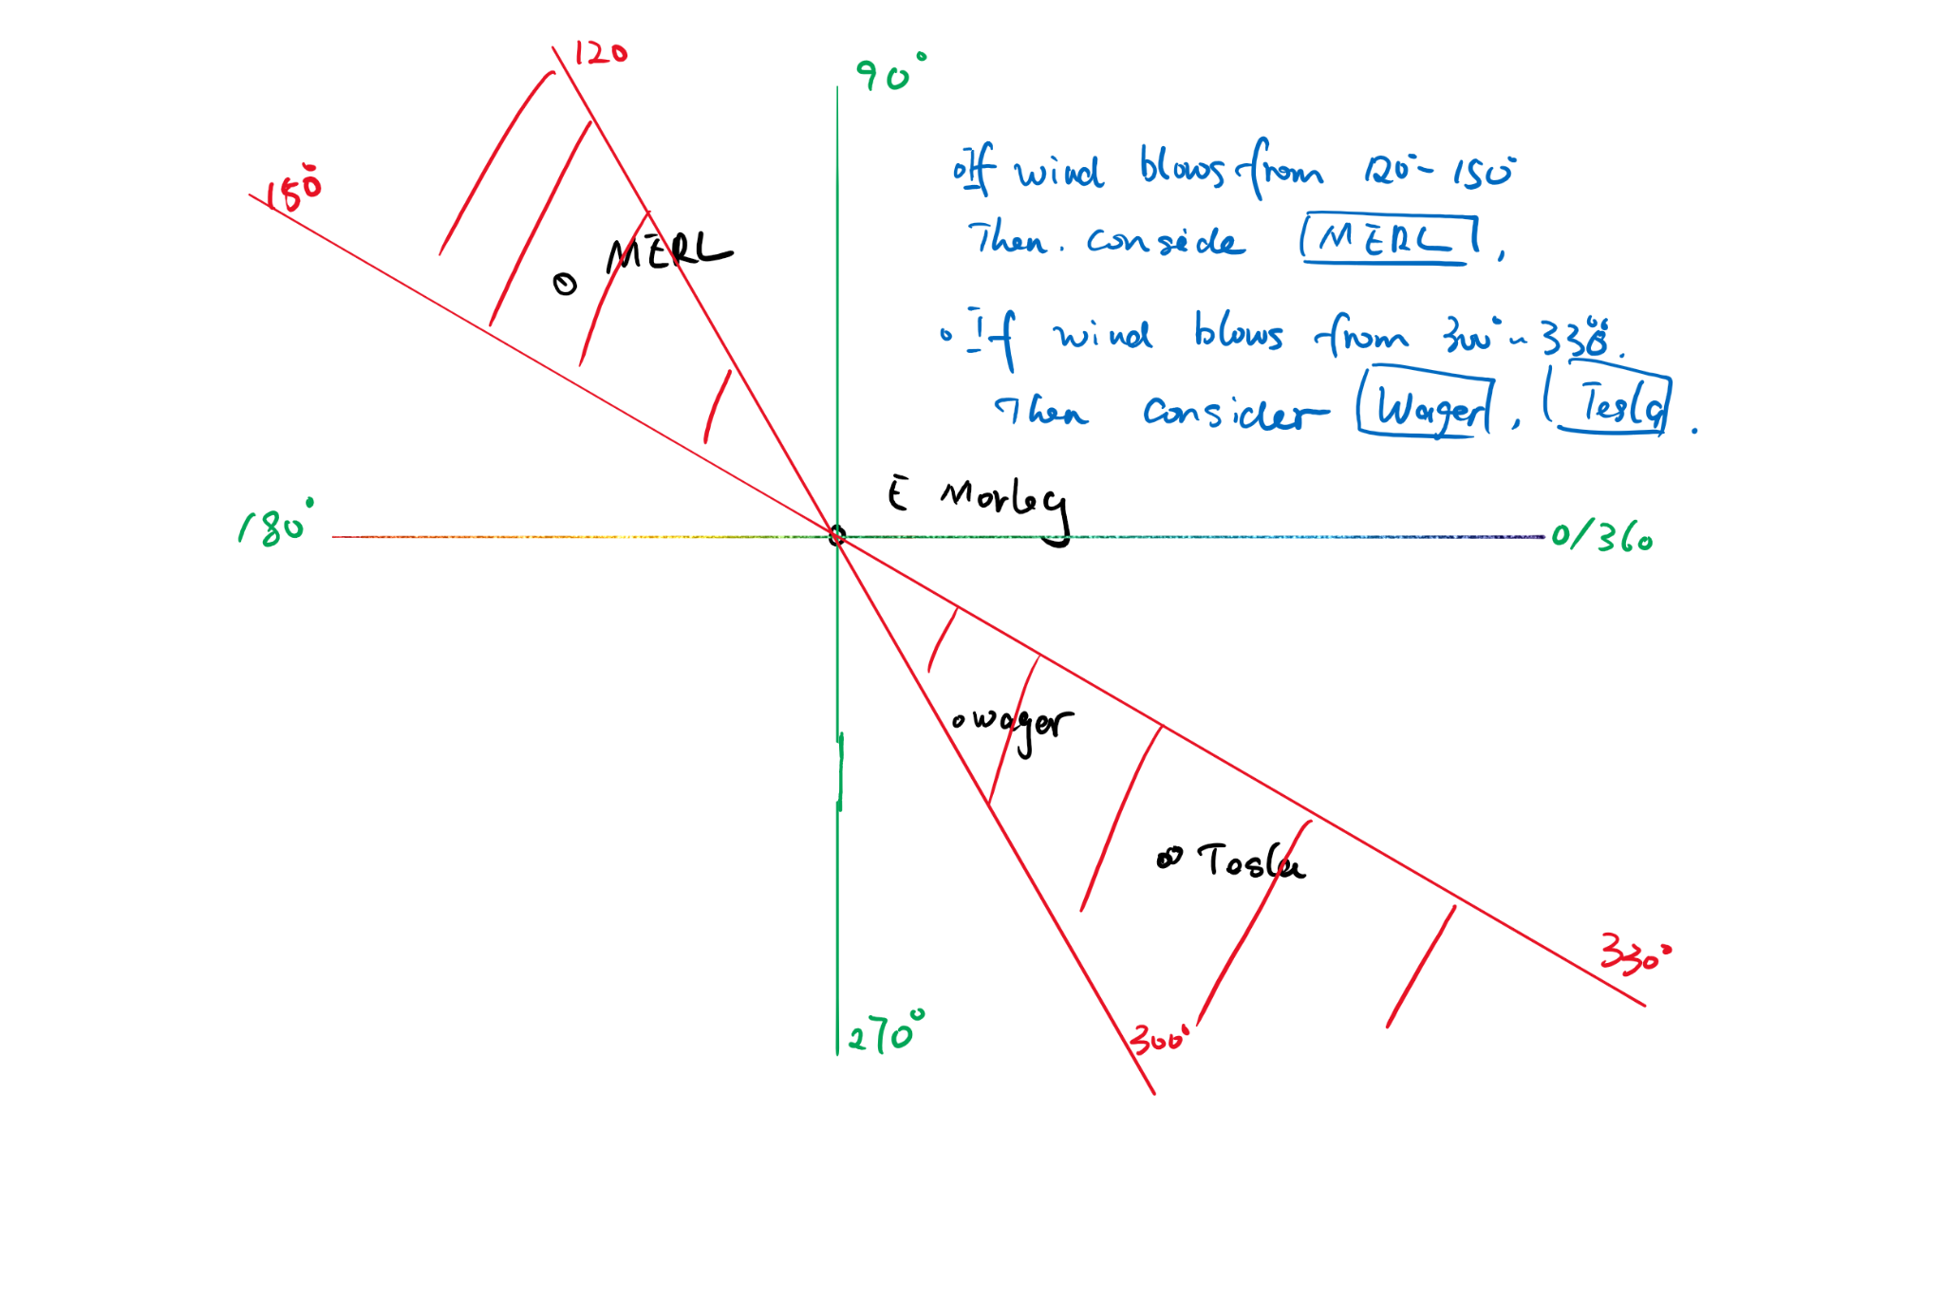
Station Selection The Approach
Dummy Variables for Wind direction
If: Wind Direction is in line with system alignment -> Dummy = 1
Else: Dummy = 0
Train Different Models: A model for each line of systems
When Forecasting: First check wind direction forecast -> choose model -> forecast

Slide 8
Models
Three Algorithms: MLP, Random Forest, Decision Tree
MLP (3 layers: 100/80/1, elu, mae) top-performer in 13/15 models
Three Benchmark Models:
Benchmark 1: Just One Feature ~ Solar Radiation
Benchmark 2: SSRD + 30 minute Lag from same Station
Benchmark 3: SSRD + 30 minute Lag from other Stations
Two Models:
i) Blackbox model with SSRD + Lags from other stations + Wind direction + wind speed
ii) Implementation of Station Selection Algorithm

Slide 9
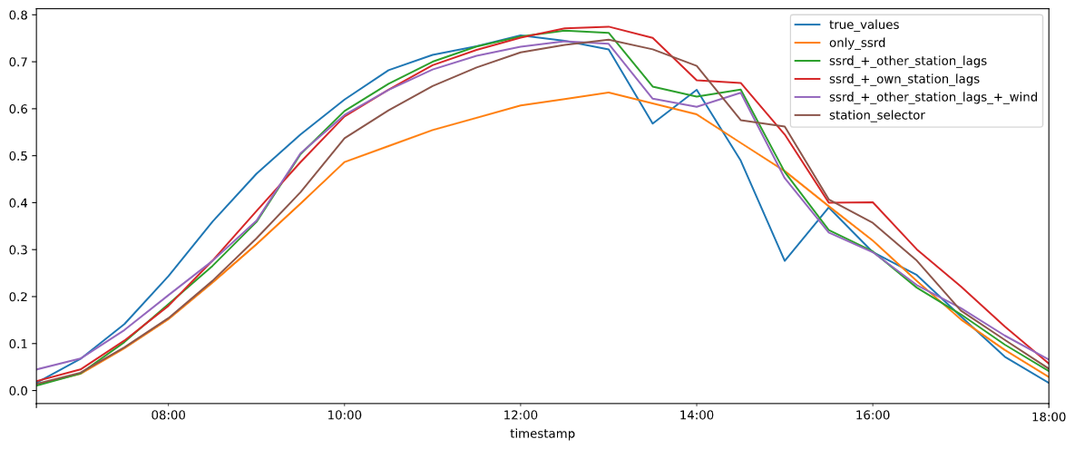
Results ~ Accuracy
 | Station Selector | Blackbox | Benchmark 1 | Benchmark 2 | Benchmark 3
RMSE Skill | 49% | 45% | 55% | 45% | 48%
MAE | 0,08 | 0,07 | 0,09 | 0,07 | 0,08

Slide 10
Conclusion & Discussion
30 minute intervals of data
Little volatility
Could not test lag selection algorithm (av wind speed = 9 m/s -> 16km cloud move per 30 minutes)
Too few peripheral systems:
Limited the availability of data as only wind from two directions could be regarded (1/80 of the data)
The issue of using lags as features:
Limited forecast horizon -> after a while you are using forecasted values as lags -> error propagation

Slide 11

Thanks! Any Questions?

